Slide 1
Doorstep
SE Sprint 1
UM1
PM: Hyunki Lee & Alexandra Ochoa
SM: David Martinez & Austin Do
Programmers: Kayhan Kishi & Oluwanifemi Owolabi

Slide 2
What is Doorstep?
Overview: An app that allows the user to order groceries from the comfort of their homes and have it delivered right to their DOORSTEP. With our advanced technology, you will know where your personal shopper is, at all times.
Purpose: To limit exposure to COVID-19 and help flatten the curve.
Target Audience: Everyone, but mostly those with higher risk of COVID-19, lower mobility, and concerned with their health.
Notes:
(Rubric note):
- describe current product’s purpose and intended target users (PM)
- describe the technical components chosen to implement the product (SM)
*Live courier tracking and delivery system using GPS of mobile device and delivery location’s GPS*

Slide 3
How will it work?
Environment/Emulator: Android Studio, Genymotion
Mock-Up Tool: Figma
Languages and Data: Java, Google Maps API
Plugins: Floobit, Git
Database: Google Firestore
Project planning: ZenHub
Communication: Discord

Slide 4
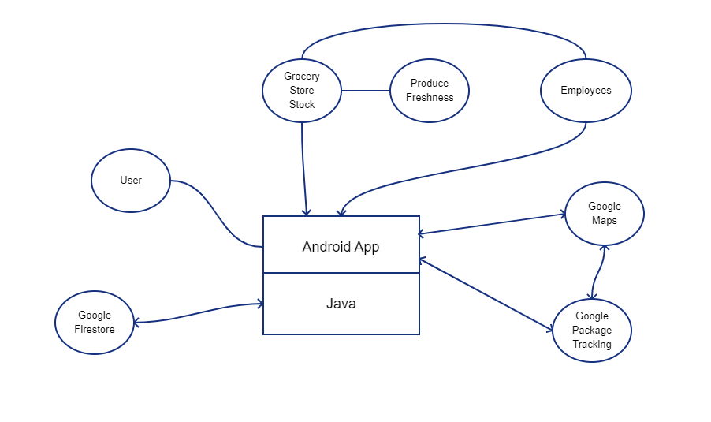
Conceptual Model

Slide 5
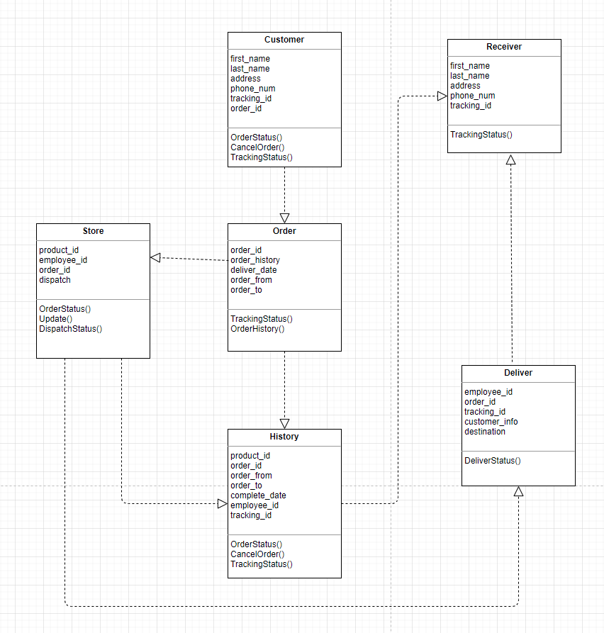
UML Diagram

Slide 6
Epics Completed
1. R&D (Research and Discovery)
Contained issues on all technologies needed and languages.
Also contained figuring out using Zenhub.
2. App Overview/Planning
App description, planning, models.
3. Communication/Collaboration
Methods of communicating and collaborating.
4.Presentation set up
Preparing for this presentation.

Slide 7
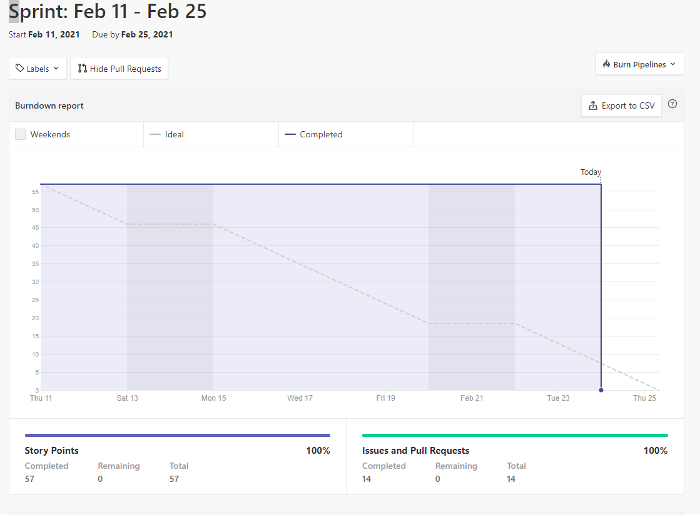
Burndown chart
Metric System:
10-30 minutes -------------+1
30 minutes - 2 hours-----+2
2 hours - 4 hours----------+3
4 hours - 6 hours---------+4
6 hours+ -------------------+5
1 person task -------------+0
2 person task -------------+2
3+ person task -----------+4

Slide 8
Application
Live Courier Mock-Up

Slide 9
Risk/Challenges Discovered
Schedule for meeting - Due to COVID, we couldn’t meet in-person. Therefore we would have to find the right time to call each other in Discord to collaborate and get everything together for the project.
Learning how to use new software(s) - Zenhub, Android Studio, Figma.
Midterm Week - Since the week of Feb. 22 is Midterm week in GSU, most of us had to take exams for other courses.

